Slide 1



Cognitive Skills Build
Scientia Pontiem System :
SKILLS BRIDGE
The Genesis Block Team

Slide 2
Cognitive Skills Build
“Falsified credentials are a growing concern for organizations”
- Information Security Media Corp.
The Genesis Block Team
SKILLS BRIDGE
Notes:
Job applicants fill their resumes with bogus academic degrees and job titles and still be accepted to their job that their applying.
Link: https://www.bankinfosecurity.com/interviews/risks-false-credentials-i-1561

Slide 3
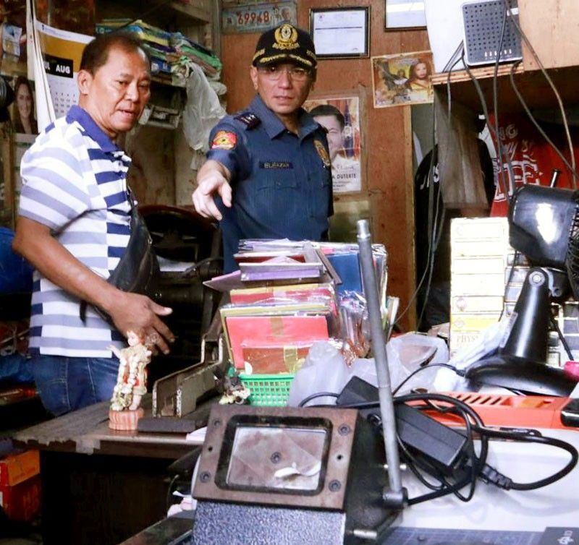

Cognitive Skills Build
22 nabbed
for fake documents in Manila
The Genesis Block Team
SKILLS BRIDGE
Notes:
Last July 2019, 22 persons were arrested in Rizal Avenue due to producing forged documents, fake diplomas, etc. The higher risk is, if the applicant that forged an document still got accepted and in a high-profile position,

Slide 4
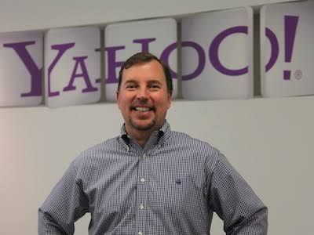
Cognitive Skills Build
Forged a degree in Accounting & Computer Science
22 nabbed
for fake documents in Manila
Scott Thompson
The Genesis Block Team
Former Yahoo CEO
SKILLS BRIDGE
Notes:
Scott Thompson former CEO of YAHOO were forced to step down on his positon, revealing that he forged a degree in Accounting and Computer Science

Slide 5

Cognitive Skills Build
2.20 million people were unemployed
The Genesis Block Team
SKILLS BRIDGE
Notes:
But despite of all jobseekers that got accepted and has fake credentials. According to Trading Economics, last year, 2019 t, here are still 2.20 million people that were unemployed

Slide 6
Cognitive Skills Build
SOLUTION
The Genesis Block Team
SKILLS BRIDGE

Slide 7
Cognitive Skills Build
SKILLS BRIDGE
The Genesis Block Team
Cognitive Skills Build

Slide 8
Cognitive Skills Build
SKILLS BRIDGE
An application that offers career portal service.
The Genesis Block Team
Cognitive Skills Build
Notes:
Skills Bridge is an application that offers career portal service. It is similar to LinkedIn, Kalibrr and Jobstreet.

Slide 9



Accurate and trusted credentials
Cognitive Skills Build
Aims to alleviate skills mismatch.
Contributes to resolve unemployment.
The Genesis Block Team
SKILLS BRIDGE
Notes:
Cite the problems discussed on the first slides to support each objective/benefits

Slide 10
Cognitive Skills Build
USERS OF THE APPLICATION
The Genesis Block Team
SKILLS BRIDGE

Slide 11




Cognitive Skills Build
JOB SEEKER
TRAINING CENTER/ EDUCATIONAL INSTITUTION
EMPLOYER
The Genesis Block Team
SKILLS BRIDGE

Slide 12
Cognitive Skills Build
HOW IT WORKS
The Genesis Block Team
SKILLS BRIDGE

Slide 13

TRAINING CENTER/ EDUCATIONAL INSTITUTION
JOB SEEKER
Embedded database in the system
Cognitive Skills Build
automatically verifies the credential or not
Verifies credentials of a
jobseeker
Recommend
needed skill/s
Applies a job in a certain business sector/ employer
The Genesis Block Team
EMPLOYER
View skills in a specific individual who can be fit for a job
SKILLS BRIDGE

Slide 14

TRAINING CENTER/ EDUCATIONAL INSTITUTION
JOB SEEKER
Embedded database in the system
Cognitive Skills Build
automatically verifies the credential or not
Verifies credentials of a
jobseeker
Recommend
needed skill/s
blockchain shared ledger
Applies a job in a certain business sector/ employer
The Genesis Block Team
EMPLOYER
View skills in a specific individual who can be fit for a job
SKILLS BRIDGE
Notes:
The data of the jobseeker and the employer will be saved using Blockchain. Blockchain, layman’s term, is a decentralized database in which data are tamper-proof because it is secured through cryptography.

Slide 15
DEMO
SKILLS BRIDGE

